Slide 1
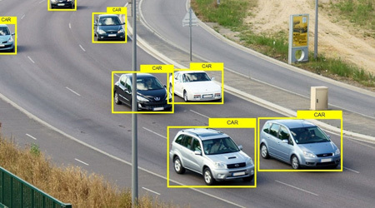
EMBEDDED AI: ROAD OBJECT DETECTION
Software and Engineering for Embedded Systems
Embedded AI (tinyML) for road object detection
Source https://www.anolytics.ai/blog/use-of-bounding-box-annotations-is-important-for-object-detection/
Deniz Dag & Murat Kezlev

Slide 2
EMBEDDED AI: ROAD OBJECT DETECTION
Software and Engineering for Embedded Systems
The Problem
Traditional AI requires a lot of computing power. To perform object detection today, most systems rely on power-hungry GPUs or expensive cloud latency. This is a deal-breaker for edge cloud for smart cities, remote monitoring, and battery-operated IoT.
The Value Proposition
Embedded machine learning has emerged as an effective approach for enabling intelligent perception on low-power devices with limited memory and computational capacity
Deniz Dag & Murat Kezlev

Slide 3
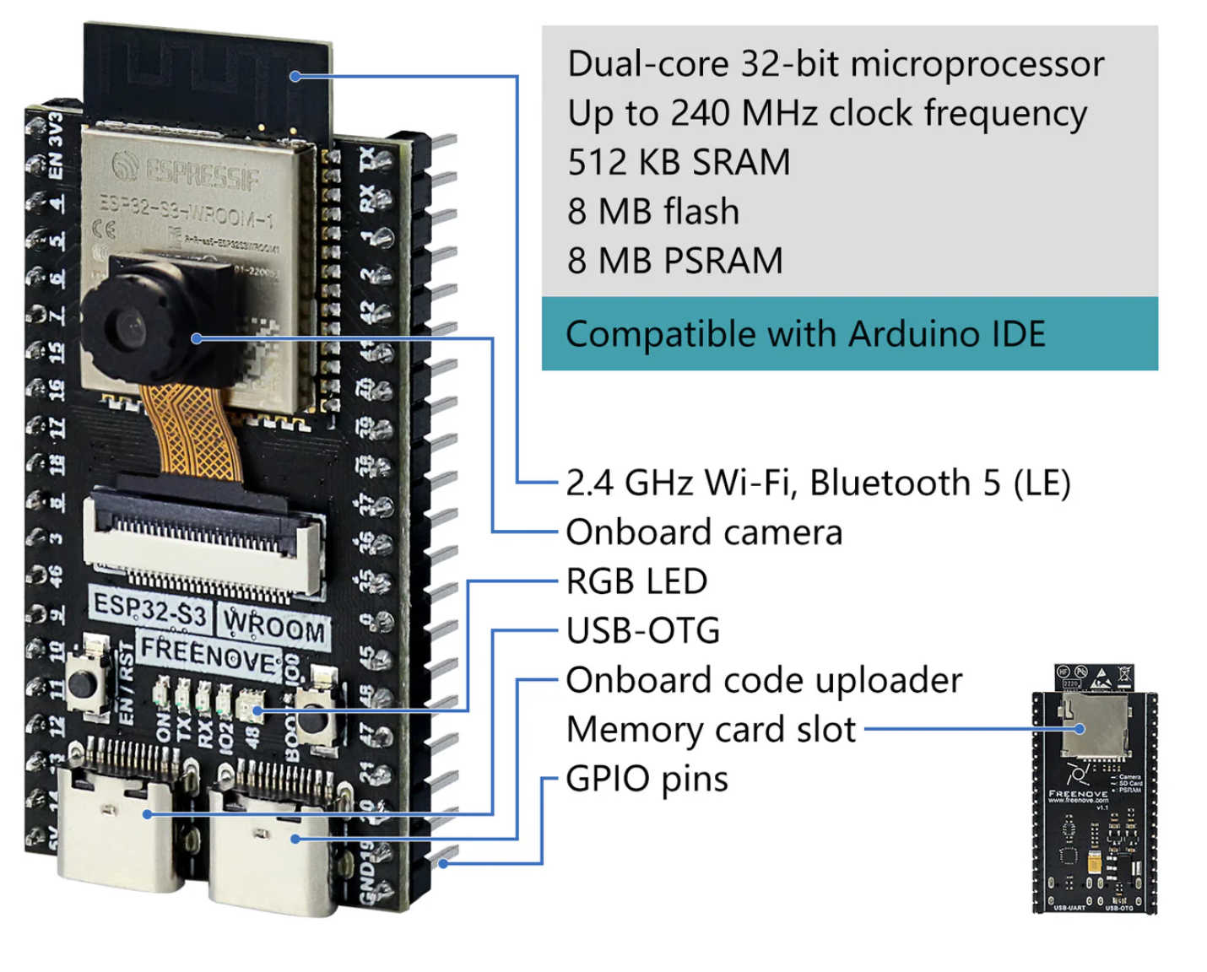
EMBEDDED AI: ROAD OBJECT DETECTION
Software and Engineering for Embedded Systems
Hardware
Development board with camera sensor
LCD screen

Slide 4
EMBEDDED AI: ROAD OBJECT DETECTION
Software and Engineering for Embedded Systems

Slide 5
EMBEDDED AI: ROAD OBJECT DETECTION
Software and Engineering for Embedded Systems
AI Model Selection
We have studied below options in depth. Given limitations of the MCU,
Criteria | FOMO MobileNetV2 | MobileNet SSD | YOLOv5n / Tiny-YOLO | Single-label MobileNetV1
Latency on ESP32-S3 | ~140–200 ms (~5–10 FPS) | ~800 ms+ (~1 FPS) | several seconds/frame | ~100 ms (~10 FPS)
RAM footprint | < 200 KB | 1 MB, needs PSRAM | > 2 MB | < 100 KB
Output type | Object centroids + class | Bounding boxes + class | Bounding boxes + class | Single class
Multi-object localization | yes | yes | yes | no
Size estimation | no | yes | yes | no
ESP-NN / TFLite Micro support | Full (Edge Impulse) | Partial (slow ops) | Requires custom porting | Full
Training pipeline | Mature (Edge Impulse Studio) | Mature but heavier | mature but heaviest | Trivial
Selection of model | Selected | Dropped - latency, RAM | Dropped - infeasible on MCU | Option - no localization

Slide 6
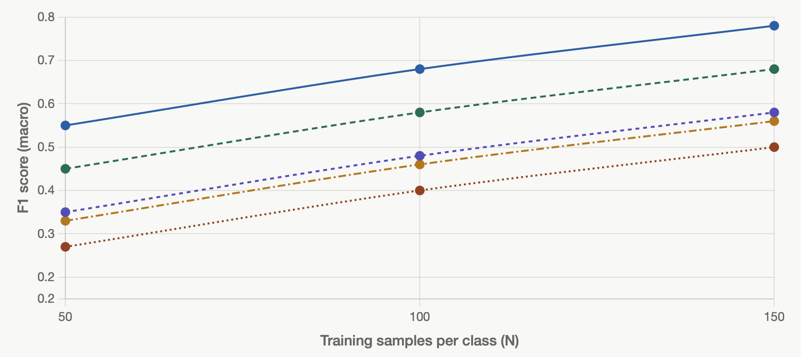





EMBEDDED AI: ROAD OBJECT DETECTION
Software and Engineering for Embedded Systems
FOMO object detection performance test with ESP32-S3 result
Set variables:
Input resolution (e.g. 96×96 grayscale)
Heatmap factor: 8. # of epochs: Learning rate: 0.001
Augmentation pipeline: INT8 quantization:
Classes: Car, Bus, Truck, Bicycle, Motorcycle

Slide 7
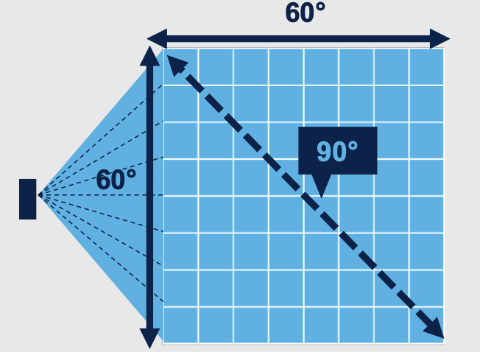

EMBEDDED AI: ROAD OBJECT DETECTION
Software and Engineering for Embedded System
How to improve performance drop with higher number of classes with given MCU?
In order to achieve production level classification & energy capability, we would like to propose a hybrid
deterministic and AI solution in multiple stages. Below system is composed of PIR sensor to wake up all system
from deep sleep state when an object detected, multi-zone ToF (Time of Flight) sensor for initial deterministic
Classification and finally camera sensor and multi-MCUs for binary AI classification; given the fact that binary AI
classification gave the highest score during tests.
Stage 1
Stage 2
Stage 3
Car /
Others
Camera
PIR
Active : ~0.3 mW
ToF
Bus
/ Others
8 x 8 matrix POI zones
MCU 2
Truck
/Others
MCU 1
Active : ~200-300 mW
D. Sleep: ~0.4 mW
WiFi interrupt
WiFi
interrupt
Bicycle
/Others
MCU 3,4,5, 6…
ToF sensor on
Camera takes shot
MCU 2 makes 1st classification (Bus)
Wake up MCU 4 (Bus)
Send picture data to MCU 4
Return to deep sleep MCU 2
Inference (binary classification) for final confirmation
If result below 80% , wake up MCU 5
Send picture data to MCU 5
Inference and output highest score class
(bus or truck)
Object detected
Wake up MCU 1
Wake up MCU 2
Return to deep sleep MCU 1

Slide 8
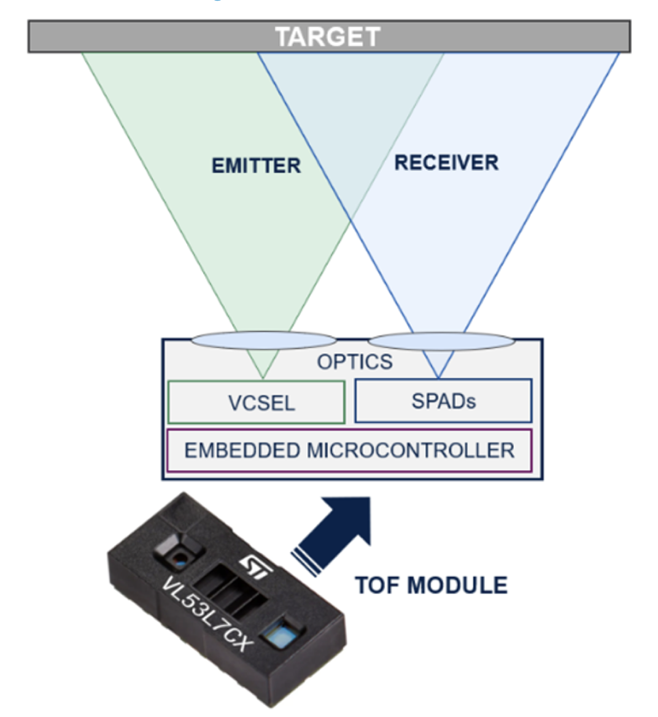
EMBEDDED AI: ROAD OBJECT DETECTION
Software and Engineering for Embedded System
How to use ToF sensor for deterministic classification?
0.1 | 0.1 | 0.2 | 0.1 | 0.1 | 0.1 | 0.1 | 0.1
0.1 | 0.1 | 0.2 | 0.1 | 0.1 | 0.1 | 0.1 | 0.1
0.1 | 0.1 | 0.2 | 0.1 | 0.1 | 0.1 | 0.1 | 0.1
0.1 | 0.1 | 0.2 | 0.1 | 0.1 | 0.1 | 0.1 | 0.1
0.1 | 0.1 | 0.5 | 0.1 | 0.1 | 0.1 | 0.1 | 0.1
0.8 | 0.7 | 0.6 | 0.3 | 0.1 | 0.1 | 0.1 | 0.1
0.7 | 0.8 | 0.9 | 0.7 | 0.1 | 0.1 | 0.1 | 0.1
0.6 | 0.7 | 0.5 | 0.7 | 0.1 | 0.1 | 0.1 | 0.1
Usual scene
Range 4 – 10 m
0.1 | 0.1 | 0.2 | 0.1 | 0.1 | 0.1 | 0.1 | 0.1
0.1 | 0.1 | 0.2 | 0.1 | 0.1 | 0.1 | 0.1 | 0.1
0.1 | 0.1 | 0.2 | 0.1 | 0.1 | 0.1 | 0.1 | 0.1
0.1 | 0.1 | 2.1 | 1.5 | 1.7 | 1.9 | 0.1 | 0.1
0.1 | 1.6 | 2.9 | 2.5 | 2.6 | 2.6 | 0.1 | 0.1
0.8 | 1.9 | 2.9 | 2.9 | 2.9 | 2.9 | 0.1 | 0.1
0.7 | 0.8 | 2.9 | 2.9 | 2.9 | 2.9 | 0.1 | 0.1
0.6 | 0.7 | 1.6 | 0.7 | 0.1 | 1.6 | 0.1 | 0.1
Speed : 50 kmh
Speed : 1.5 m x 2.5 m
→ Car

Slide 9
EMBEDDED AI: ROAD OBJECT DETECTION
Software and Engineering for Embedded Systems
FOMO (Faster Objects, More Objects) MobileNet – What it is and Advantages
Conventional object detection methods attempt to predict bounding boxes by estimating the precise width and height of each object, a process that imposes considerable computational and memory overhead. FOMO reduces this burden by simplifying assumptions
Why it’s preferred for the ESP32-S3
Speed: FOMO is roughly 30x faster than MobileNet SSD. On the ESP32-S3, you can achieve 10–20 frames per second, whereas YOLO might take several seconds per frame.
Memory: It can run in less than 200KB of RAM. Since the ESP32-S3 has 512KB, this leaves plenty of room for your camera buffer and other code logic.
Counting: Because it works on a grid, it is naturally very good at counting many objects (like multiple cars in a parking lot) without needing the complex "Non-Maximum Suppression" math that YOLO requires.
Deniz Dag & Murat Kezlev

Slide 10
EMBEDDED AI: ROAD OBJECT DETECTION
Software and Engineering for Embedded Systems
FOMO (Faster Objects, More Objects) MobileNet - Drawbacks
The advantages are achieved at the cost of several limitations.
No Size Detection: FOMO won't tell if a car is "large" or "small" in the frame. It assumes all objects are roughly the same size as the grid cells.
Minimum Distance: If two objects are so close that their centers fall into the same grid cell, FOMO will only count them as one object.
Square Assumption: FOMO works best when objects are somewhat square or circular. Extremely long, thin objects can sometimes confuse the grid.
Deniz Dag & Murat Kezlev

Slide 11
EMBEDDED AI: ROAD OBJECT DETECTION
Software and Engineering for Embedded Systems
TensorFlow Lite for Microcontrollers (TFLM)
Standard TFLite Micro is an interpreter-based runtime. When ESP32 boots up, TFLite allocates a chunk of RAM (aka the tensor arena), loads the model dynamically from a .tflite flatbuffer file, parses the model graph at runtime, and maps out how to route data through the layers.
The interpreter itself takes up valuable Flash space, and the generic graph overhead eats up RAM.
Deniz Dag & Murat Kezlev

Slide 12
EMBEDDED AI: ROAD OBJECT DETECTION
Software and Engineering for Embedded Systems
TensorFlow Lite for Microcontrollers (TFLM)
Standard TFLite Micro is an interpreter-based runtime. When ESP32 boots up, TFLite allocates a chunk of RAM (aka the tensor arena), loads the model dynamically from a .tflite flatbuffer file, parses the model graph at runtime, and maps out how to route data through the layers.
The interpreter itself takes up valuable Flash space, and the generic graph overhead eats up RAM.
Deniz Dag & Murat Kezlev

Slide 13
EMBEDDED AI: ROAD OBJECT DETECTION
Software and Engineering for Embedded Systems
Conclusion
By combining curated vehicle datasets, Edge Impulse’s FOMO architecture, grayscale preprocessing, and embedded-oriented optimization strategies, the Embedded ML object detection offers
Real-Time Responsiveness (Ultra-Low Latency) for edge cloud and IoT: Processing happens at the source not at the central cloud
Cost Efficiency: Battery-powered low cost MCUs reports "Spot Occupied" or "Spot Empty" using local inference, instead of expensive, high-speed cameras wired to a central computer
Privacy and Data Security : Sensitive information stays on site instead of sending to central cloud.
Extreme Power Longevity: Many real-world sensors are placed in locations where they cannot be plugged into a wall
Bandwidth Independence : The device operates fully offline. No need to upload heavy image files to perform its task. A vehicle counter on a remote bridge to monitor structural load, can log traffic data for months and only sync the final "count" once a month via a low-bandwidth connection
Deniz Dag & Murat Kezlev

